Slide 1
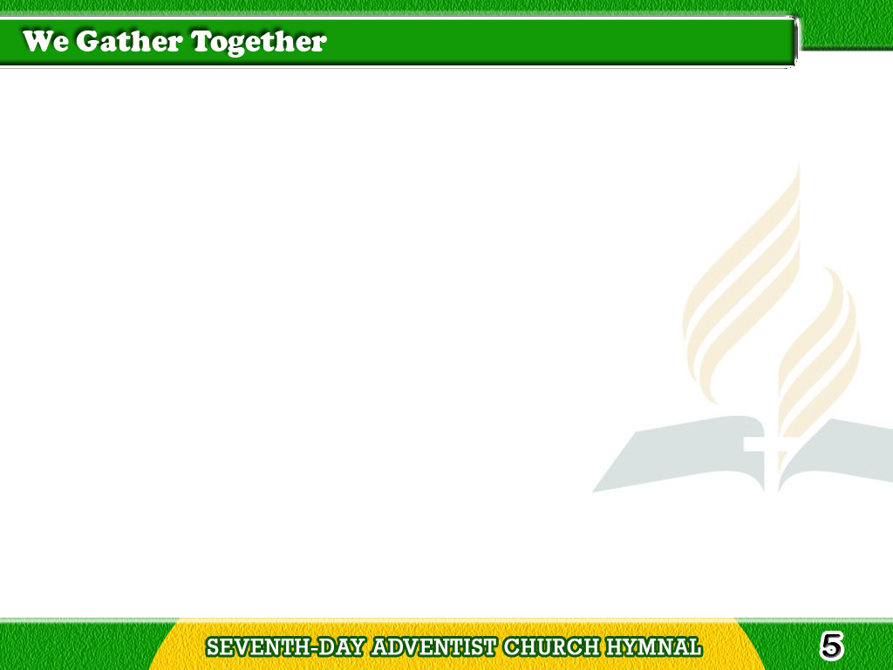
1/3
We gather together to
ask the Lord’s blessing;
He chastens and hastens
His will to make known;
Tagalog
Version

Slide 2
1/3
The wicked oppressing
now cease from distressing,
Sing praises to His name;
He forgets not His own.
Tagalog
Version

Slide 3
2/3
Beside us to guide us,
our God with us joining,
Ordaining, maintaining
His kingdom divine;
Tagalog
Version

Slide 4
2/3
So from the beginning the
fight we were winning;
Thou, Lord, was at our side;
all glory be Thine!
Tagalog
Version

Slide 5
3/3
We all do extol Thee,
Thou Leader triumphant,
And pray that Thou still
our Defender wilt be.
Tagalog
Version

Slide 6
3/3
Let Thy congregation
escape tribulation;
Thy name be ever praised!
O Lord, make us free!
Tagalog
Version

